Slide 1
Gender Pay Gap
The Dollar-And-Cents Case :
Hidden factors behind the story
Ishrath Ayesha Ajmal, Shuyuan Yang, Purnima Tripathi, Mishita Agarwal, Yuan Cheng

Slide 2
Dollar & Cent Story
According to an article by Forbes - Undergraduate women from Harvard believe that when they are going to earn, they will be getting 78 cents on the dollar compared to men just because they are women. Those women admitted to Harvard can be distinguished from the smartest, most talented and most dedicated of their high school peers but it is sad that even at that situation they are in a position to be worried about their future pay.
https://www.forbes.com/sites/karinagness/2016/04/12/dont-buy-into-the-gender-pay-gap-myth/

Slide 3
Project Purpose & Claim

Slide 4
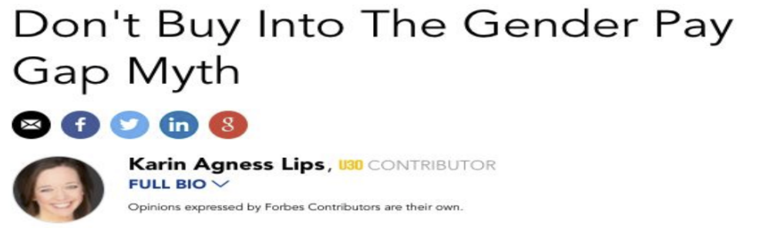
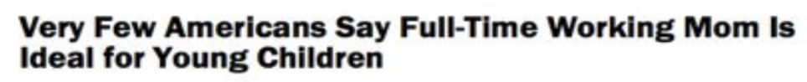
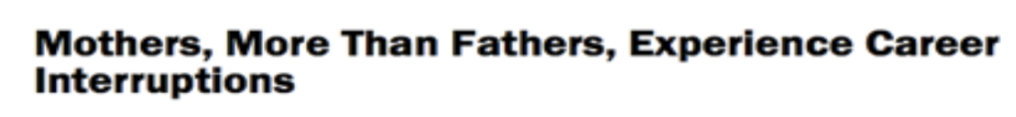
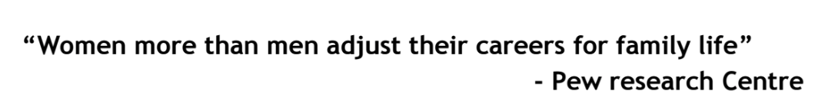
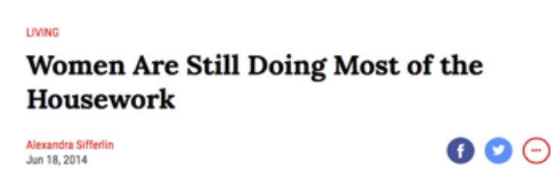
Background

Slide 5
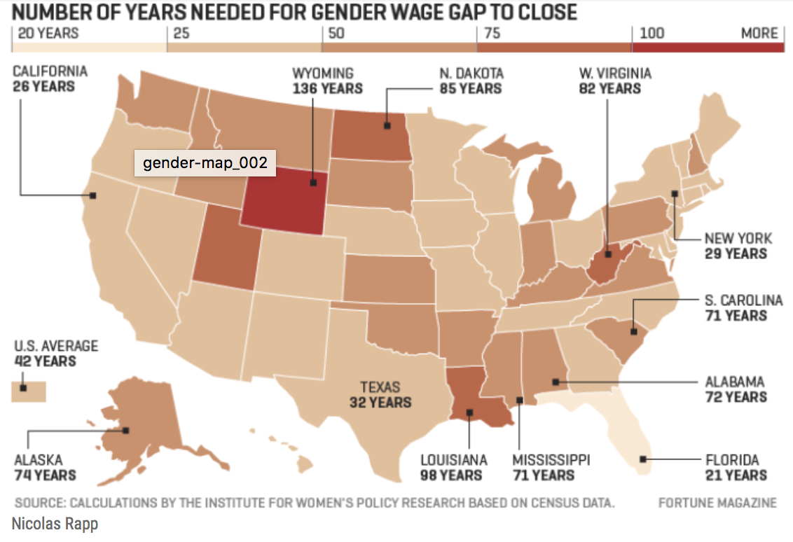

Slide 6
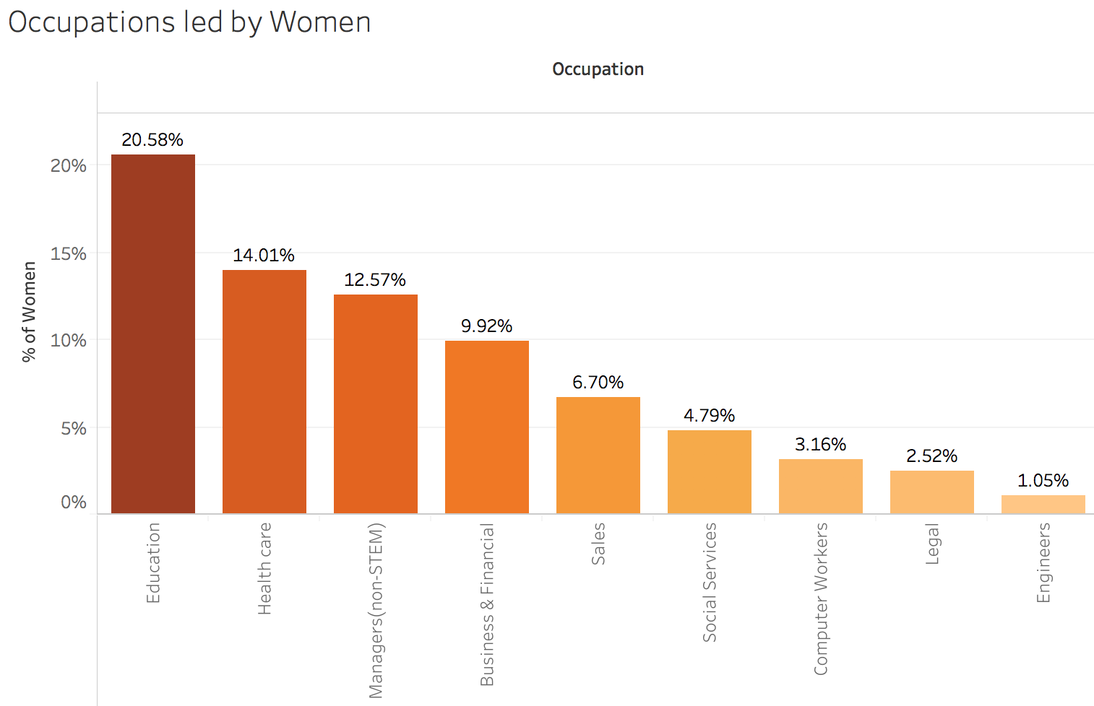
Occupations - Women in the Lead

Slide 7
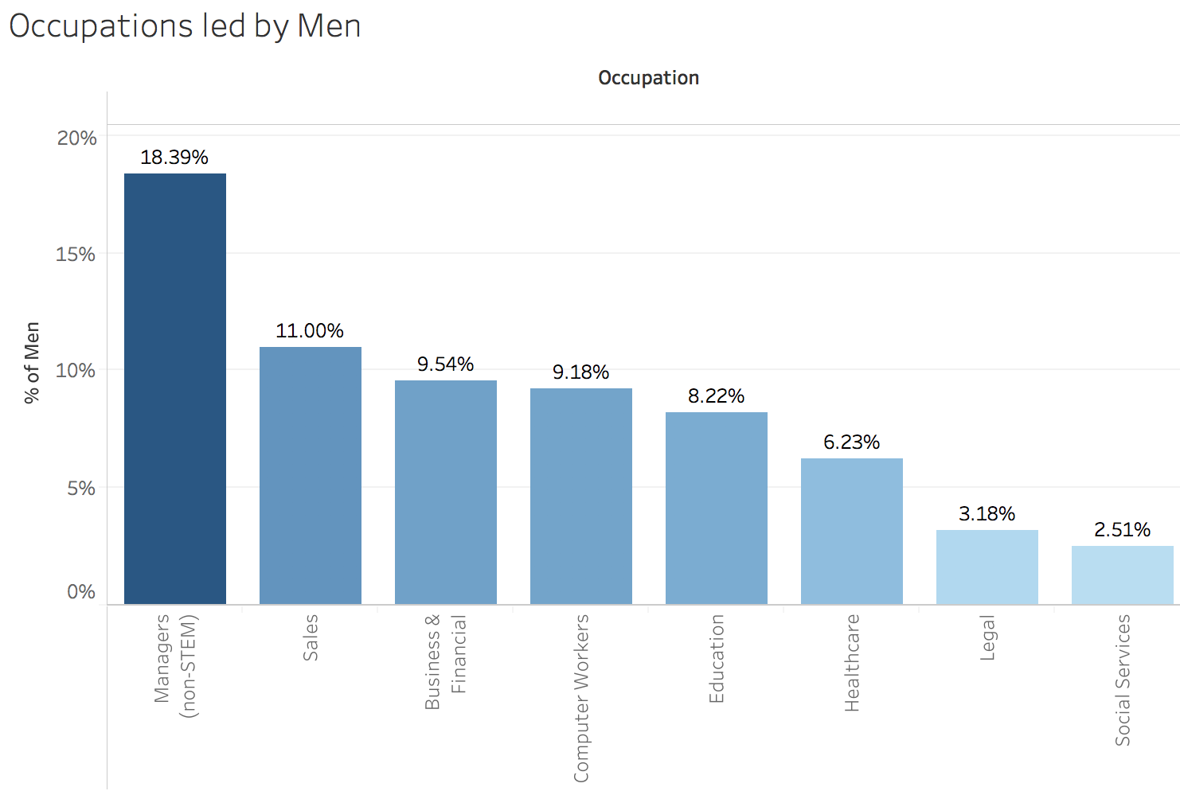
Occupations - Men in the Lead

Slide 8
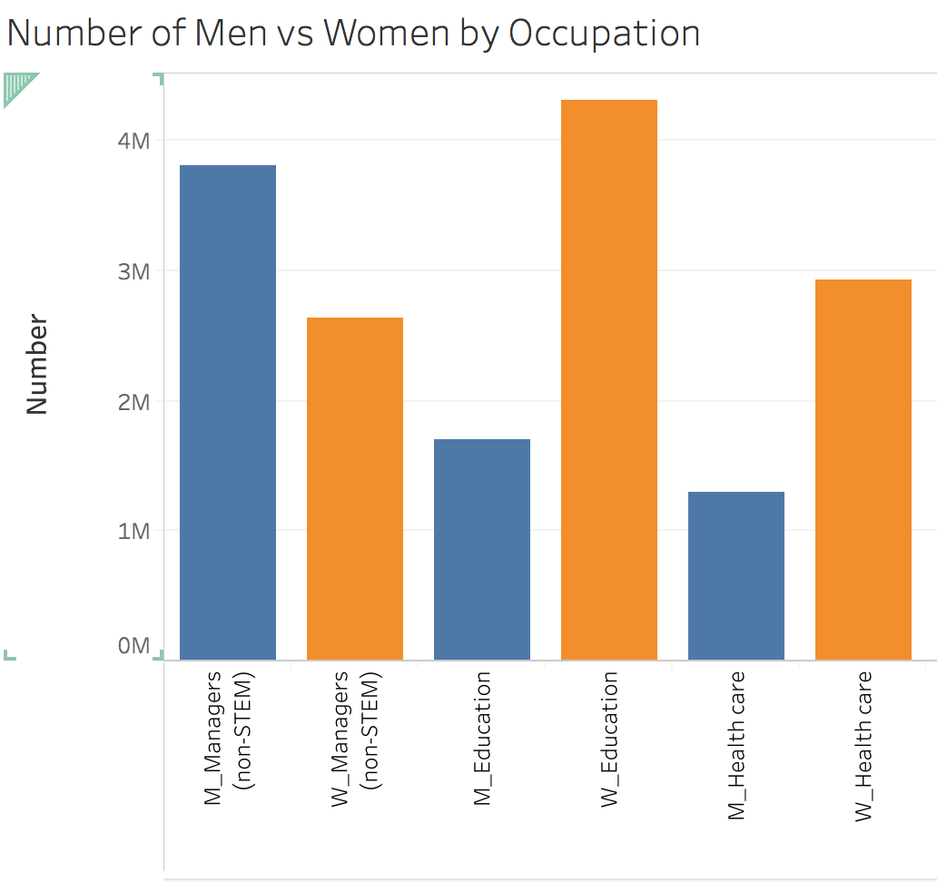
Overview number of men vs women by occupation

Slide 9
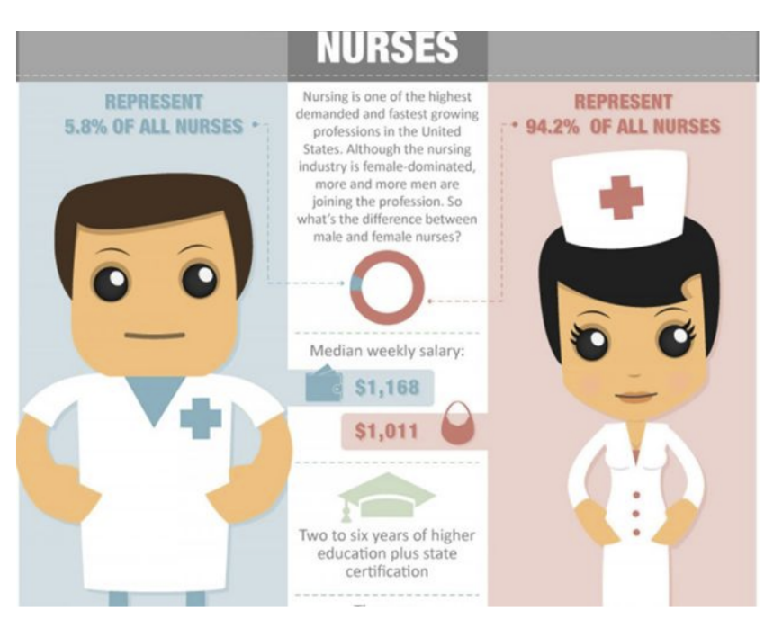
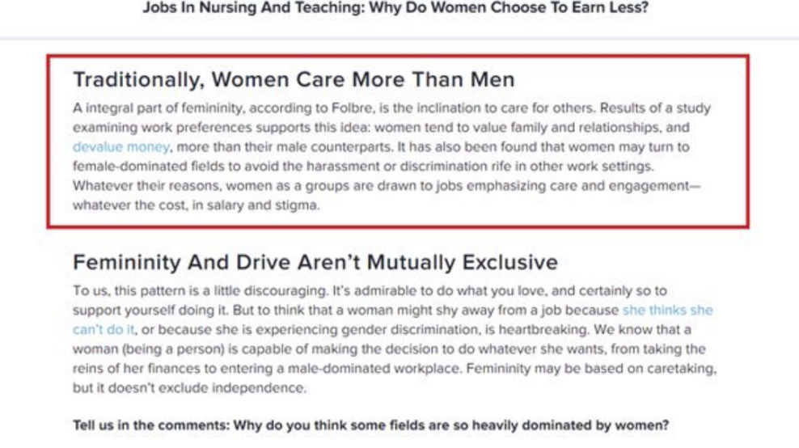
Continued - Overview number of men vs women by occupation

Slide 10
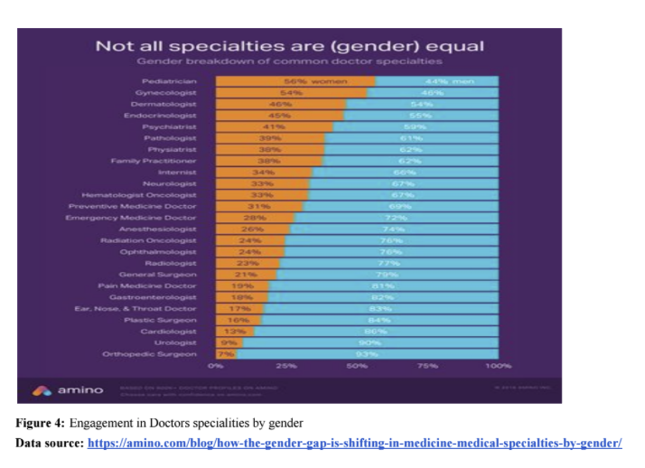
Continued - Overview number of men vs women by occupation

Slide 11
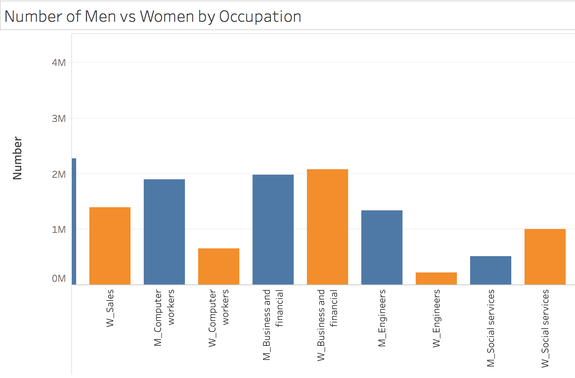
Overview number of men vs women by occupation

Slide 12
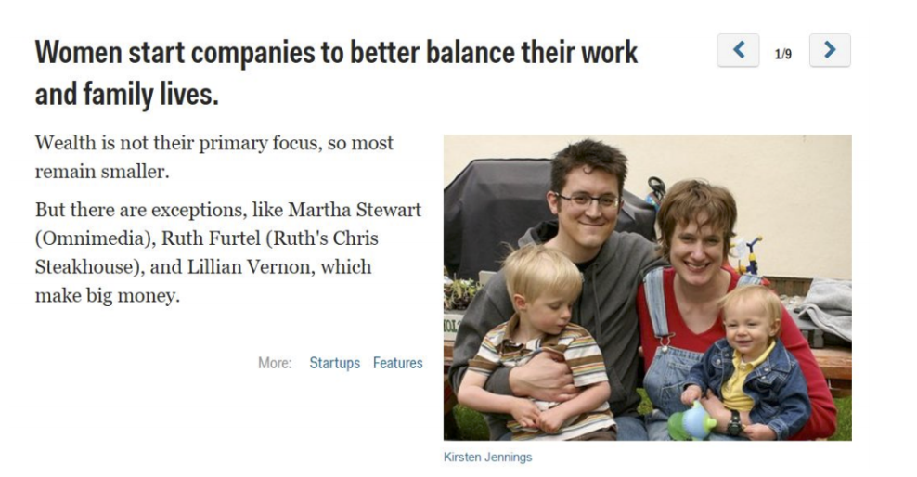

Slide 13
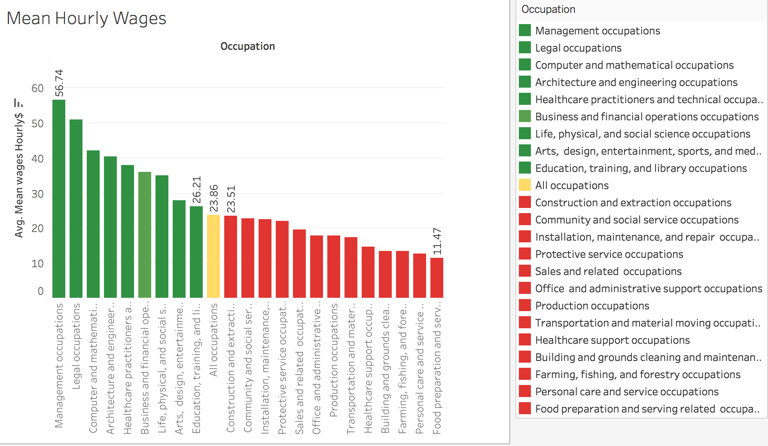
Average hourly pay in these occupation

Slide 14
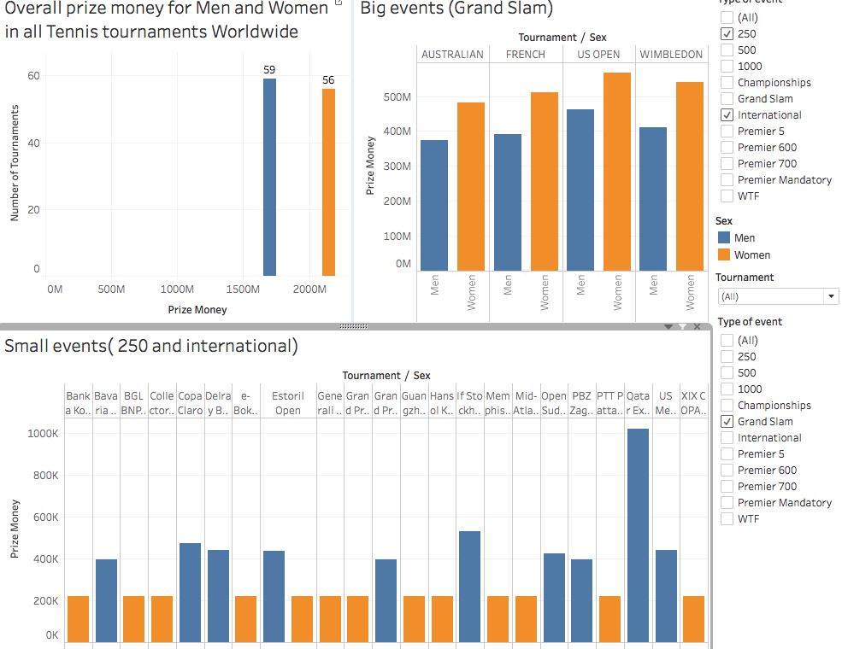
SPORTS -
Where Men and Women get equal pay

Slide 15
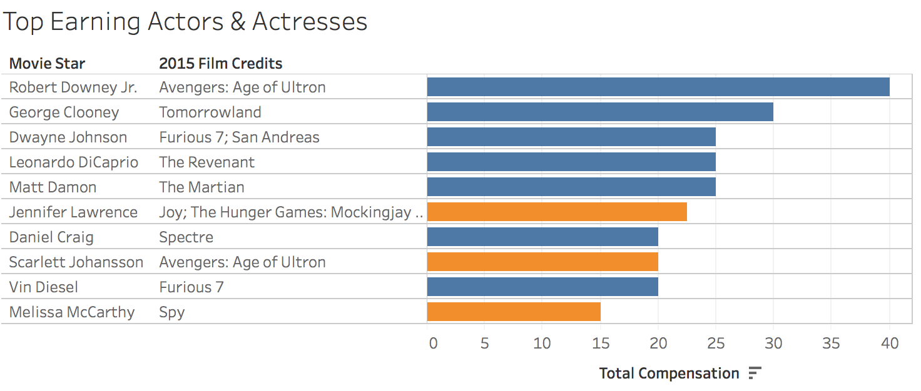
Top paid Actors in Hollywood Movies (Male and Female)

Slide 16
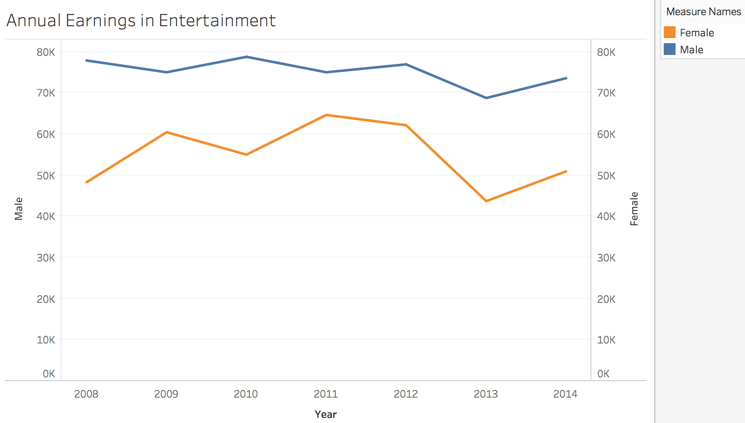

Slide 17
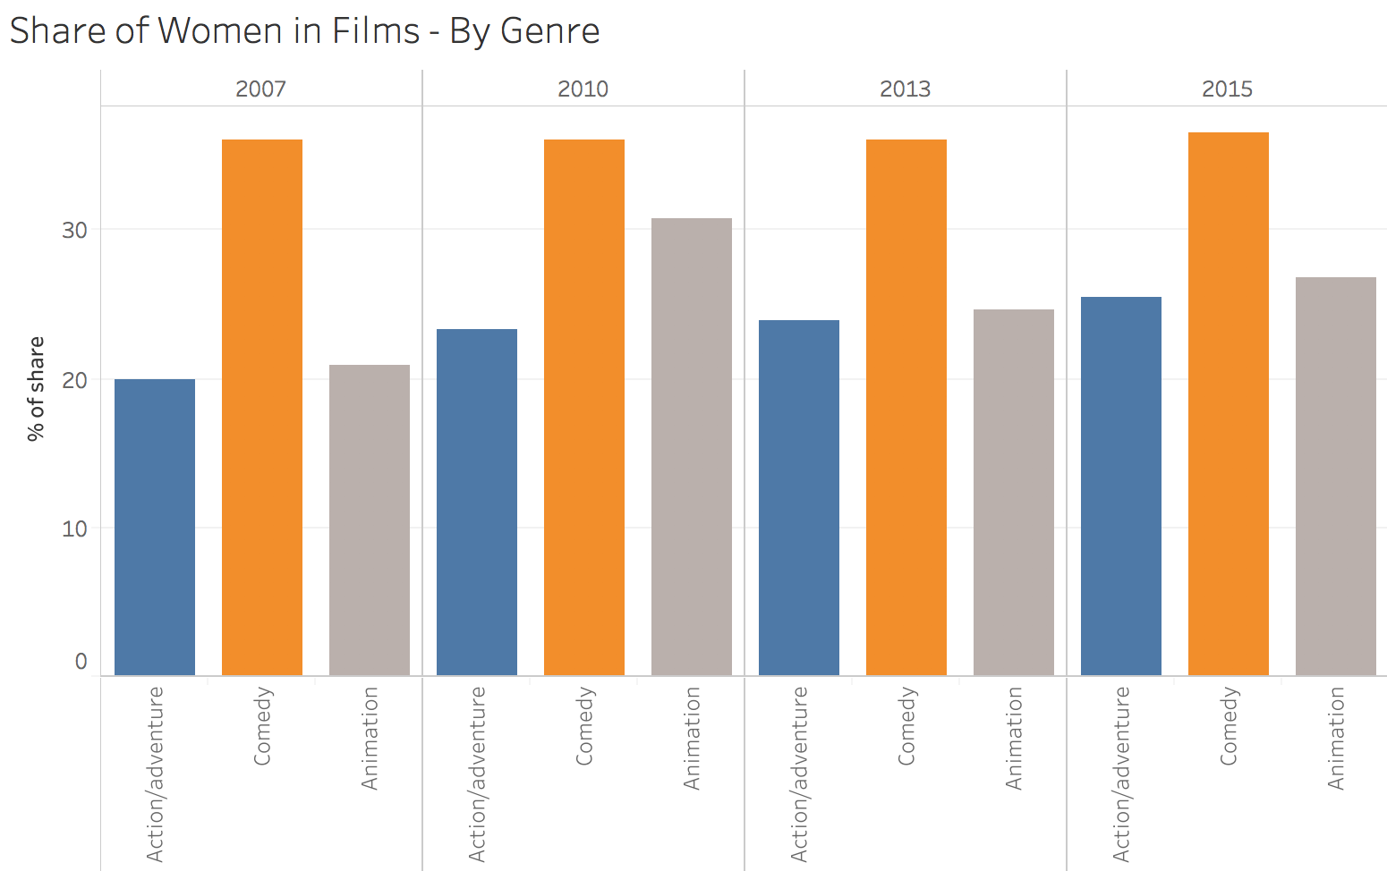
Percentage of female actors in different Genre

Slide 18
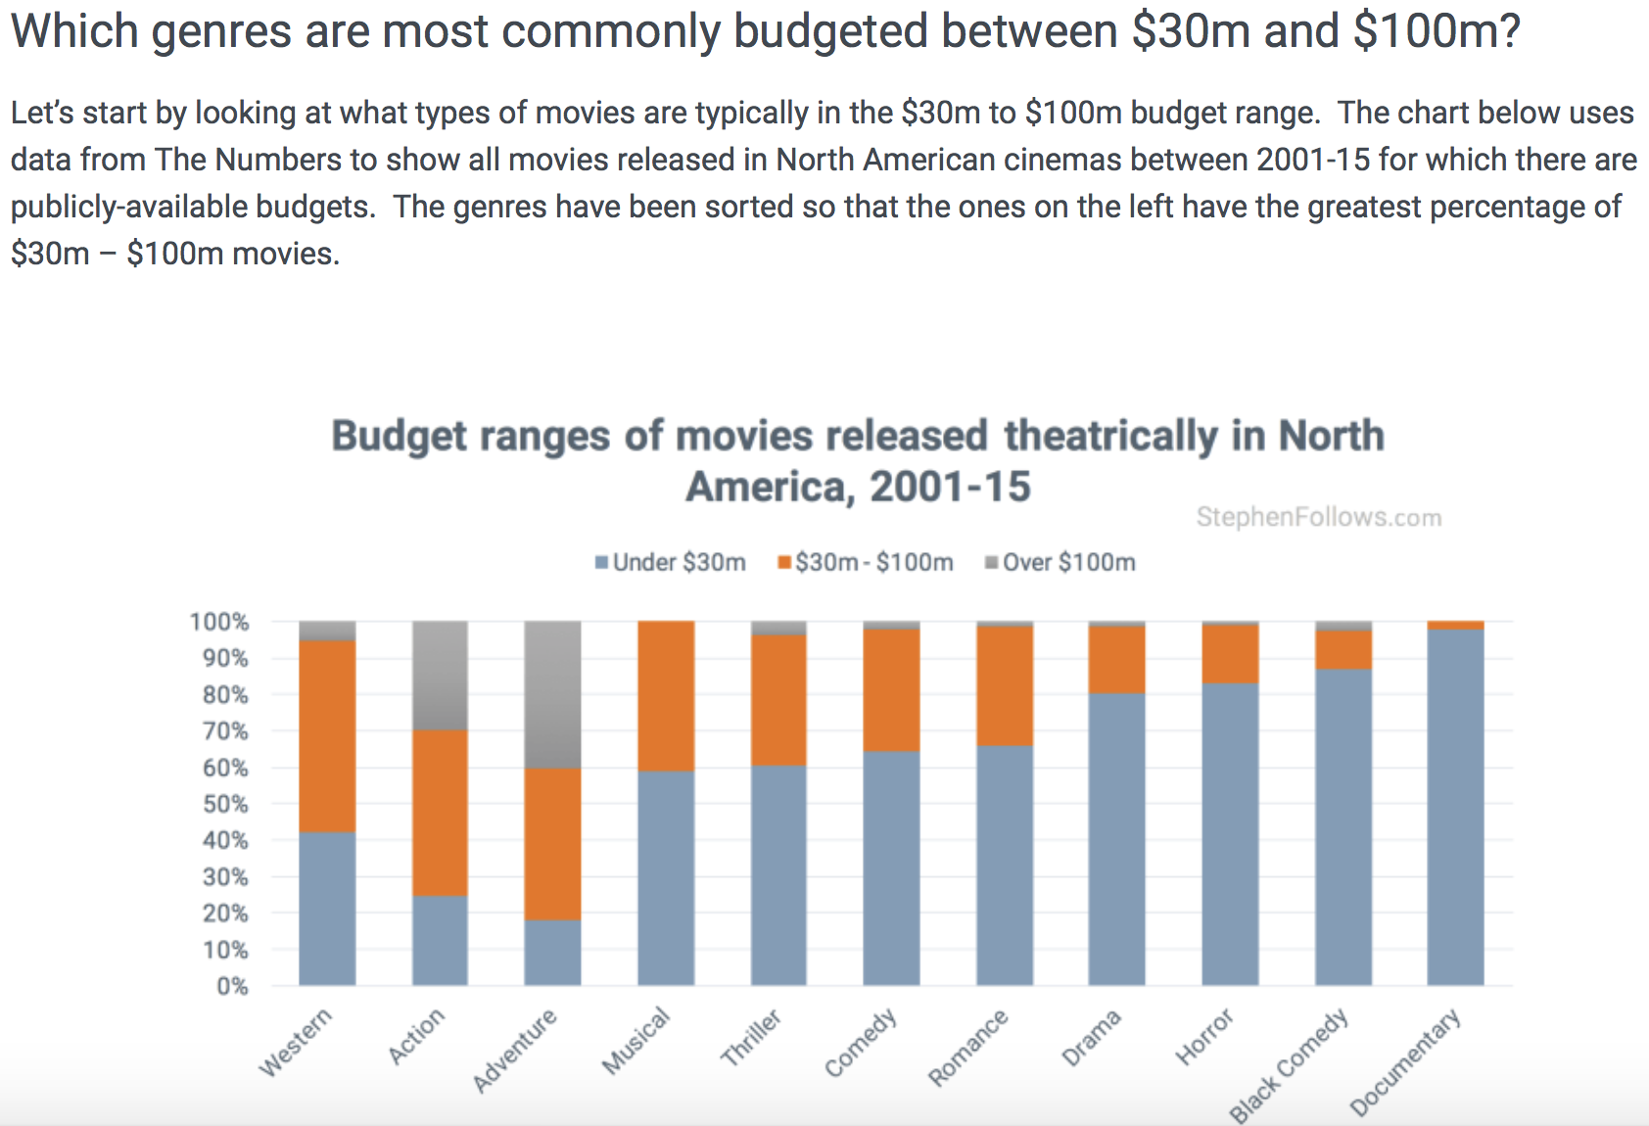
https://stephenfollows.com/films-make-money-pt2-30m-100m-movies/
Notes:
Average Budget of these movies according to Genre

Slide 19
What is the problem?

Slide 20
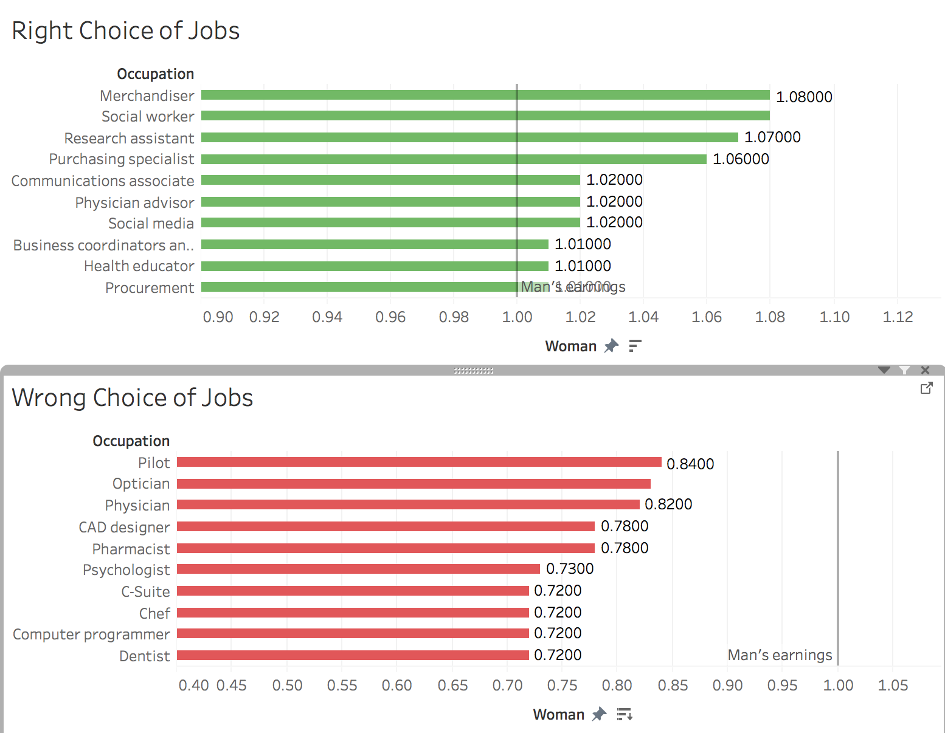
Chin up Ladies:
Pick up the right job and aim to opt for higher paying jobs from childhood ;)

Slide 21
What can we do?

Slide 22
